Slide 1

Making this resource work for you
Prior to teaching this lesson, please refer to the ‘Unit Overview and Planning Document’.
Further guidance on planning Science Mastery lessons can be found in the detailed planning guidance document.
Refer to the ‘notes’ section on each slide for useful information, including suggested expositions, pedagogical content knowledge, suggested questions, answers and more. Consider using presenter mode so you can see this guidance throughout the lesson.
The introduction slides can be adapted to suit your teaching style and the needs of your class.
Before the lesson, adapt the fix-it slide to address any misconceptions identified in the previous lesson’s exit ticket.
Choose from the suggested activities to suit your class. The intention is not that you complete all of these, but that you select those which ones are most appropriate for your students. It may be appropriate to further adapt activities for your students.
These lessons are designed to occupy approximately 1 hour. To adapt for a shorter or longer lesson duration we advise you to adapt the activity section accordingly.
Please consider using the final slide to send feedback about this lesson or examples of PowerPoints that you have adapted to our design team. Your feedback is used to improve Science Mastery for all of our teachers and students. We appreciate all suggestions and comments.
Thank you for reading!
The Science Mastery Team

Slide 2
Balancing Equations
Answer the questions below.
On which side of a chemical equation are reactants found?
What does a subscript represent in a chemical formula?
Why is mass conserved in chemical reactions?
How many of each atom are present in 2Fe₂O₃?
Is the following equation balanced? Explain your answer.
N₂ + H₂ → NH₃
The left hand side (before the arrow).
The number of that type of atom present in the formula.
Atoms are not created or destroyed, only rearranged.
4 iron atoms, 6 oxygen atoms.
No as there are more N atoms on the reactant side and more Hydrogen atoms on the product side. They should be equal.
Notes:
Big idea: Reactions rearrange matter.
Foundation question: identify how many of each atom are present in H₃PO₄.
Answer: 3 hydrogen atoms, 1 phosphorus atom and 4 oxygen atoms.
Stretch: compare the meaning of subscripts and coefficients in chemical equations.
Answer: subscripts are within the chemical formula, indicating how many of each type of atom are present. Coefficients are added when writing equations to ensure that equations are balanced and there are the same number of atoms in the reactants and products.

Slide 3
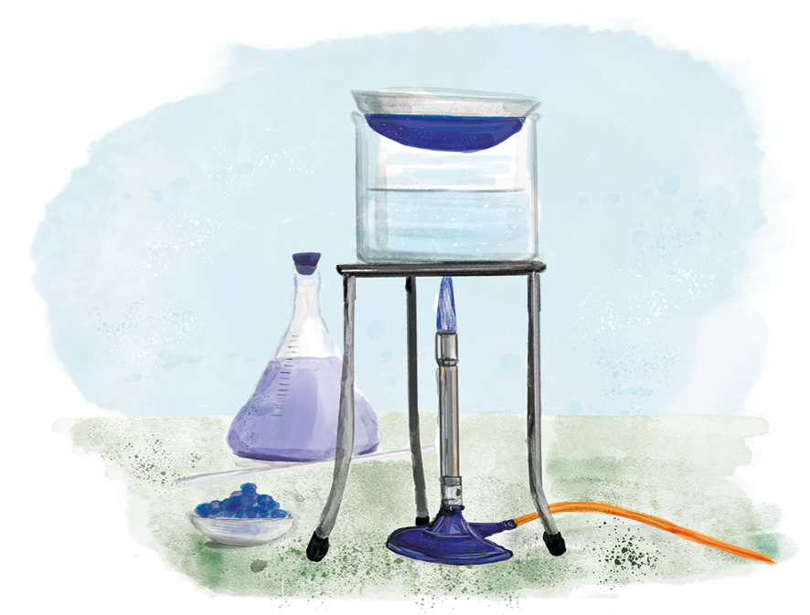

C3.2.5
11/02/2025
Balancing Equations
C3.2.1 Prior Knowledge Review
C3.2.2 Relative Formula Mass
C3.2.3 Percentage by Mass
C3.2.4 Conservation of Mass
C3.2.5 Balancing Equations
C3.2.6 Uncertainty
C3.2.7 Introducing Concentration
C3.2.8 Concentration Calculations
C3.2.9 Soluble Salts
C3.2.10 Making Soluble Salts
C3.2.11 Making Soluble Salts 2
Notes:
Big idea: Reactions rearrange matter.
By this point, students should be comfortable with determining if an equation is balanced, based on their knowledge and application of conservation of mass, subscripts and coefficients. In this lesson, you will be modelling how to approach balancing an equation, and students will be given plenty of practice. This will allow them to be more comfortable with determining the products of reactions in their future study.
Suggested hook: Write H₂ + O₂ → H₂O onto the whiteboard and ask the students how you would fix this equation. Emphasise that if you added a subscript 2 to water, you would actually be creating an entirely new compound – hydrogen peroxide. Hydrogen peroxide is used in hair dyes, bleaches and bathroom cleaners – you definitely don’t want to drink it like you would water!

Slide 4

Following this lesson, students will be able to:
Identify the number of atoms of each element in a chemical formula
Describe the significance of placing a coefficient in front of a chemical formula in an equation
Balance chemical equations
Key Words:
reactant
atom
subscript
product
coefficient
element

Slide 5
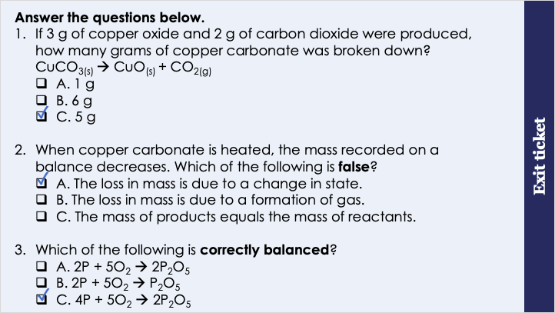
This is the fix-it portion of the lesson
The fix-it is an opportunity to respond to gaps in knowledge, especially those identified by the previous lesson’s exit ticket.
The teacher should customise this slide as needed, to facilitate
reteach, explanation, demonstration or modelling of ideas and concepts that students have not yet grasped or have misunderstood.
practise answering specific questions or of key skills.
redrafting or improving previous work.
Notes:
Purpose: to spend time on any gaps identified in previous learning from exit ticket feedback.
Fix-it guidance from previous exit ticket:
Q1. Answer: C
If students answer A, they have (incorrectly) taken the mass of carbon dioxide away from the mass of copper oxide, which indicates that they have not grasped how the total mass of the reactants should be equal to the total mass of the products, and therefore do not yet understanding the law of conservation of mass as it relates to the mass of substances in an equation. If the student answers B, they have multiplied he two values together, showing a similar misunderstanding of the relevance of the masses of reactants and products. To fix-it, use molymods to explain what we mean by conservation of mass in a chemical reaction. Build molecules using molymods to represent the three substances in this question to demonstrate for students how the mass before and after the reaction should be the same. Ask students to complete similar questions, where the mass of some substances in a chemical reaction is provided, and students should use the law of conservation of mass to deduce the unknown mass.
Q2. Answer: A
If students answer B or C, students may have the misconception that a change in state is a chemical reaction, and that this might result in a change in mass. To fix-it, describe the difference between a chemical and physical change, and link this back to conservation of mass.
Q3. Answer: C
If students answer A or B, they are unable to recognise a balanced equation, or may be confused about the notation used: subscript and large numbers. To fix-it, give students a list of chemical equations, and ask them to list the elements represented and the number of atoms for each one.

Slide 6
We can follow these steps to balance any chemical equation.
Step 1: Write out the equation neatly and divide it into two parts, reactants and products.
H₂ + O₂ → H₂O
2
2
Step 2: List the elements on each side and check they are the same.
Hydrogen
Hydrogen
2 atoms
2 atoms
4 atoms
4 atoms
Oxygen
Oxygen
Step 3: Count the number of atoms of each element shown.
2 atoms
1 atom
2 atoms
Step 4: Add coefficients to the equation to change the number of atoms to make them equal on both sides.
Rule: You can only add coefficients. You can’t add subscripts or element symbols.
Notes:
Key exposition: “Chemical equations must always be balanced. If not, it appears as if atoms are made or destroyed in a chemical reaction.“
Walk students through each step on this slide slowly, modelling the process on the board as you go. Narrate your thought process for students so they can use this same process later.
Insist that students write out the equation neatly and divide the left and right sides using a line, with a ruler. Note that this line always falls on the arrow, not necessarily the ‘middle’ of the equation.
Steps 1-3 should be easy for most pupils as they have done this extensively in the previous lesson.
Step 4 is where students will need the most guidance. Firstly, frame this exercise as a puzzle. Students will not be expected to get the answer straight away. The process is one of trial and error. Students should be encouraged to try different solutions until they find the correct one. Where students don’t want to ‘mess up’ their page, allow them to use scrap paper to work it out, but do ensure that they are working it out. Stress that the key learning objective here is applying the process correctly and not just in obtaining the correct answer at the end.
For step 4, it’s important for pupils to understand what adding a coefficient means in real terms. It’s adding multiples of that substance. Use molymods to show that putting a 2 in from of the hydrogen in this example means another hydrogen molecule.
Another key point to make students aware of is that when hydrogen and oxygen react, it’s not just one or two molecules, it’s usually millions. An equation is a representation of how the reaction proceeds as a whole, even though it looks like we’re only looking at a small number of molecules.
We will not be using state symbols in this lesson. To avoid confusion these will be introduced later.
Suggested script: Now, I am going to model how to balance any chemical equation. As I go through the steps, you will write it out in your books as shown on the board, neatly, using a ruler. Firstly, I’m going to write out my equation, leaving space on the page so that I am able to write coefficients in front of my chemical formulae. Next, I’m going to divide the equation into two parts, drawing a line, using a ruler, from the middle of the arrow, downwards. You will always need to draw the line from the arrow, as the number of reactants and products you have can vary. Next, we need to list the elements we have on each side of the equation and check that they are the same. What elements are in the reactants? Hydrogen and oxygen. And what elements do we have in the products? Hydrogen and oxygen. Good, at this point we just double-check that we have the same elements on each side, as if we don’t, we’ve done something wrong. We are good to go! Now, like before, we are going to write down the number of atoms we have of each element on each side of the equation. On the reactant side, how many atoms of hydrogen do we have? 2. And oxygen? 2. Great, now let’s check the product side, how many atoms of hydrogen do we have? 2. And oxygen? 1. Ok, great. So is this equation currently balanced? No. Good, now we are going to experiment with some trial and error by adding coefficients to the equation and seeing what happens! I will start by identifying what side of the equation has fewer atoms, and going from there. Which side of the equation has a lower number of atoms overall? The product side. Good, so I’m going to add a 2 to the front of H2O to start things off. Adding the number 1 won’t do anything, as it will just be 1 times whatever we already have, giving the same result. Now that I have added a 2 in front of water, what effect will that have on the number of atoms? There will now be 4 hydrogen atoms and 2 oxygen atoms. Correct, so I need to update the number of atoms that I have written down. Is the equation balanced now? No, not yet. Correct, so now I need to move back to the reactant side and see what changes I can make to ensure that the number of atoms on each side is the same. I can see that the number of oxygen atoms is now the same, so I’m not going to touch that, but I have only 2 hydrogen atoms on this side compared to 4 on the product side. How can I fix this? By adding a 2 in front of the H2. Perfect. I then update the number of atoms and I can see that it is now the same on each side! So my equation is now balanced. Let’s try another one.

Slide 7
We can follow these steps to balance any chemical equation.
Step 1: Write out the equation neatly and divide it into two parts, reactants and products.
C₂H₆ + O₂ → CO₂ + H₂O
Step 2: List the elements on each side and check they are the same.
Step 3: Count the number of atoms of each element shown.
Step 4: Add coefficients to the equation to change the number of atoms to make them equal on both sides.
Rule: You can only add coefficients. You can’t add subscripts or element symbols.
Notes:
Trickier example for classes where students are already very comfortable! Will be too challenging for those still grappling with it.
Now that students have seen the steps they need to follow, this example is for the teacher to model the entire process again, with a different equation.
Model and narrate the thought process for students aloud. Purposely write down an incorrect coefficient at first to show the importance of being resilient and a trial and error mentality.
Correct answer: 2C₂H₆ + 7O₂ → 4CO₂ + 6H₂O

Slide 8
Drill
What is a coefficient?
Coefficients must never be…
What must you ensure when balancing an equation?
What is the first step in balancing chemical equations? What is the second step in balancing chemical equations? What is the third step in balancing chemical equations? What is the 4th step in balancing chemical equations? What must you never do when balancing equations?
In the equation below, how many H are present on each side?
In the equation below why can’t I use H₂O₂ instead of 2H₂O?
CH_{4(g)} (g) + 2O_{2(g)} → CO _{2 (g)} + 2H₂O _{(g)}
Notes:
Purpose: This is a knowledge drill. The purpose of this is to check that the critical knowledge is secure before pupils move onto independent practice.
Suggested guidance: There are a range of ways this could be done depending on time and ability range of the class:
Mini whiteboards
As full sentences in exercise books
As short answers in exercise books
In the pupil workbook
As pair talk
As cold call

Slide 9
Drill answers
The number in front of a chemical formula
Subscripted
The number of atoms of each element are the same before and after the reaction
Write the equation neatly, divide it into two parts
List the elements on each side and check they are the same
Count the number of atoms of each element
Add coefficients to the equation to change the number of atoms to make them equal on both sides
Can't add subscripts or extra symbols
4
H₂O₂ is hydrogen peroxide, only H₂O is produced in the reaction
Notes:
Purpose: This is a knowledge drill. The purpose of this is to check that the critical knowledge is secure before pupils move onto independent practice.
Suggested guidance: There are a range of ways this could be done depending on time and ability range of the class:
Mini whiteboards
As full sentences in exercise books
As short answers in exercise books
In the pupil workbook
As pair talk
As cold call

Slide 10
I: We can follow these steps to balance any chemical equation.
Step 1: Write out the equation neatly and divide it into two parts, reactants and products.
4
2
K + O₂ → K₂O
Step 2: List the elements on each side and check they are the same.
Potassium
Potassium
2 atoms
1 atom
4 atoms
4 atoms
Step 3: Count the number of atoms of each element shown.
Oxygen
Oxygen
2 atoms
1 atom
2 atoms
Step 4: Add coefficients to the equation to change the number of atoms to make them equal on both sides.
Rule: You can only add coefficients. You can’t add subscripts or element symbols.
Notes:
Now that students have seen the steps they need to follow, this example is for the teacher to model the entire process again, with a different equation.
Model and narrate the thought process for students aloud. Purposely write down an incorrect coefficient at first to show the importance of being resilient and a trial and error mentality.
The correct answer is below. Any multiples are acceptable.
Correct answer: 4K + O₂ → 2K₂O

Slide 11
We: We can follow these steps to balance any chemical equation.
Step 1: Write out the equation neatly and divide it into two parts, reactants and products.
2
2
Na + Cl₂ → NaCl
Step 2: List the elements on each side and check they are the same.
Sodium
Sodium
1 atom
1 atom
2 atoms
2 atoms
Step 3: Count the number of atoms of each element shown.
Chlorine
Chlorine
2 atoms
1 atom
2 atoms
Step 4: Add coefficients to the equation to change the number of atoms to make them equal on both sides.
Rule: You can only add coefficients. You can’t add subscripts or element symbols.
Notes:
Now that students have seen the steps they need to follow, this example is for the teacher to model the entire process again, with a different equation.
Model and narrate the thought process for students aloud. Purposely write down an incorrect coefficient at first to show the importance of being resilient and a trial and error mentality.
The correct answer is below. Any multiples are acceptable.
Correct answer: 2Na + Cl₂ → 2NaCl

Slide 12
You: We can follow these steps to balance any chemical equation.
Step 1: Write out the equation neatly and divide it into two parts, reactants and products.
3
2
3
Fe₂O₃ + CO → Fe + CO₂
Step 2: List the elements on each side and check they are the same.
Iron
Iron
1 atom
2 atoms
2 atoms
Step 3: Count the number of atoms of each element shown.
Oxygen
Oxygen
4 atoms
2 atoms
6 atoms
6 atoms
Step 4: Add coefficients to the equation to change the number of atoms to make them equal on both sides.
Carbon
1 atom
Carbon
1 atom
3 atoms
3 atoms
Rule: You can only add coefficients. You can’t add subscripts or element symbols.
Notes:
Now that students have seen the steps they need to follow, this example is for the teacher to model the entire process again, with a different equation.
Model and narrate the thought process for students aloud. Purposely write down an incorrect coefficient at first to show the importance of being resilient and a trial and error mentality.
The correct answer is below. Any multiples are acceptable.
Correct answer: Fe₂O₃ +3CO → 2Fe + 3CO₂

Slide 13
How do I balance an equation?
The number of atoms of each element is balanced in a symbol equation e.g. there are 2 oxygen atoms on each side of this equation:
2Mg + O₂ → 2MgO
Let’s balance the following equation:
H₂ + O₂ → H₂O
How many atoms of each element?
Box the substances.
More oxygen needed – add a box.
Now how many atoms of each element?
More hydrogen needed – add a box.
Now how many atoms of each element?
It is now balanced
H₂
H₂O
x4
x4
H x2
O x2
H x2
O x1
x2
Notes:
PhET Link: https://phet.colorado.edu/sims/html/balancing-chemical-equations/latest/balancing-chemical-equations_en.html
This activity helps students to visualise what the actual meaning of the coefficients is in terms of reactants and products.
This works even better if students can each access and play with this on their own on computers or ipads.
It can be run where you place students in groups and ask them to work out the solution together (like a quiz), and then score each team when they get it correct.
This slide contains an alternative method which can be used to balance equations.
This slide recaps learning from unit C2.2 (Changing Substances). It might be appropriate for some classes to revisit ideas from that unit – feel free to add slides/activities, or to reteach lessons from that prior unit so that students start this unit with all necessary prior knowledge.
It is worth emphasising what the numbers before and after the symbols mean.
There is a good video explaining the box method: https://www.youtube.com/watch?v=ZL7N8RZ4vfY see video link. The slide mirrors the video so could be taught with or without the video.

Slide 14
Balance this chemical equation.
__H₂O₂ → __H₂O + __O₂
2
2
Notes:
Answer: 2H₂O₂ → 2H₂O + O₂

Slide 15




Which of the following do you think best represents a chemical reaction?
+
→
1
+
→
+
2
→
+
3
+
Notes:
Talking points:
1. Equation 1 does not represent a chemical reaction very well because the components of the reactants is not the same as those in the products – there are more parts in the reactants.
2. Equation 2 is a good representation of a chemical reaction. This might be an opportunity to pick up on the misconception that substances have to be mixed for a reaction to take place. This is not true (e.g. thermal decomposition). Students often assume that chemical reactions are synthesis reactions and assume that decompositions are physical changes because they're being broken up.
3. Equation 3 does not represent a chemical reaction because there is no change – the components (or atoms) do not rearrange.
Suggested guidance:
Talk tasks can be used in a variety of ways to suit the particular needs of the students you are teaching. Through exchanging views with others, students develop their understanding of the science beyond what could be achieved individually.
Science classrooms that successfully integrate talk have the following features:
Science talk is a regular feature of lessons and is woven into classroom activities.
Students are paired or grouped strategically by the teacher to ensure productive interaction. This might take into consideration the students’ proficiency of the English language, how encouraging they might be to peers and their attainment in the topic. It’s a good idea to consider these pairings in the class seating plan.
Students are encouraged and supported to talk, but are not forced to talk.
The teacher should take on the role of a facilitator, engaging with conversations where necessary and encouraging or steering the conversation where needed.
Students are encouraged to use the language they have to express their ideas (e.g., everyday language, imperfect English, native language), but also to incorporate science specific terminology where this is more accurate or has been taught.
6. Scientifically inaccurate ideas are not dismissed by the partner or teacher; open discussion and further investigation are relied on to help students construct ideas that support them to progress in their scientific understanding.
7. Guidelines for behaviour during talk tasks are explicit and frequently reviewed. Rules for students might be:
Listen carefully to your partner
Take turns talking.
Speak one at a time, without interrupting.
Politely agree or disagree and explain why.
Politely point out if your partner has used a scientific word incorrectly, if they have explained the science incorrectly, or if there is a more accurate way to describe something.
If confused, ask questions.
Stay focused on the discussion topic.
Respond to one another.

Slide 16
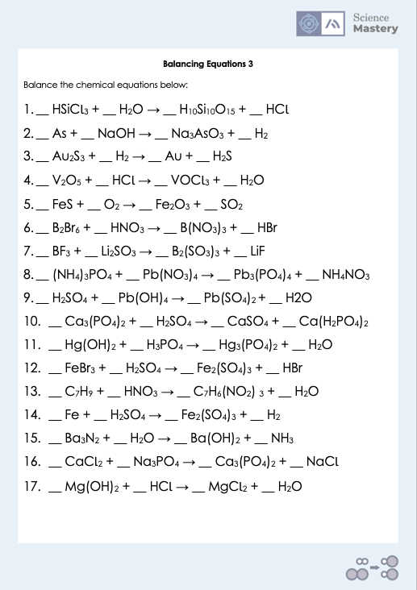
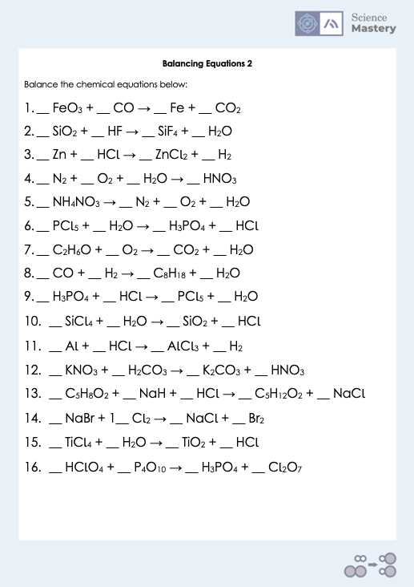
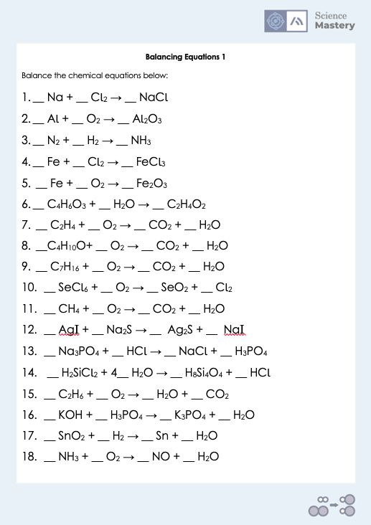
Practice: Balancing equations
Notes:
There are three worksheets with equations to balance. Sheet 1 is the lowest difficulty. Sheet 3 is the most difficult with equations including brackets.
Remind students that although there is space to write coefficients, in many instances they may not need to include them.
Consider the number and difficulty of questions you give to students. You can ask them to work these out in pairs for additional support. Display the rules and a worked example for students to refer to.
All answers are on one answer sheet for the teacher.

Slide 17
Answers
Practice Sheet 1 Answers
2 Na + Cl₂ → 2 NaCl
4 Al + 3 O₂ → 2 Al₂O₃
N₂ + 3 H₂ → 2 NH₃
2 Fe + 3 Cl₂ → 2 FeCl₃
4 Fe + 3 O₂ → 2 Fe₂O₃
C₄H₆O₃ + H₂O → 2 C₂H₄O₂
C₂H₄ + 3 O₂ → 2 CO₂ + 2 H₂O
C₄H₁₀O+ 6 O₂ → 4 CO₂ + 5 H₂O
C₇H₁₆ + 11 O₂ → 7 CO₂ + 8 H₂O
SeCl₆ + O₂ → SeO₂ + 3 Cl₂
CH₄ + 2 O₂ → CO₂ + 2 H₂O
2 AgI + Na₂S → Ag₂S + 2 NaI
Na₃PO₄ + 3 HCl → 3 NaCl + H₃PO₄
4 H₂SiCl₂ + 4 H₂O → H₈ Si₄O₄ + 8 HCl
2 C₂H₆ + 7 O₂ → 6 H₂O + 4 CO₂
3 KOH + H₃PO₄ → K₃PO₄ + 3 H₂O
SnO₂ + 2 H₂ → Sn + 2 H₂O
4 NH₃ + 5 O₂ → 4 NO + 6 H₂O

Slide 18
Answers
Practice Sheet 2 Answers
FeO₃ + 3 CO → Fe + 3 CO₂
SiO₂ + 4 HF → SiF₄ + 2 H₂O
Zn + 2 HCl → ZnCl₂ + H₂
2 N₂ + 5 O₂ + 2 H₂O → 4 HNO₃
2 NH₄NO₃ → 2 N₂ + O₂ + 4 H₂O
PCl₅ + 4 H₂O → H₃PO₄ + 5 HCl
C₂H₆O + 3 O₂ → 2 CO₂ + 3 H₂O
8 CO + 17 H₂ → C₈H₁₈ + 8 H₂O
H₃PO₄ + 5 HCl → PCl₅ + 4 H₂O
SiCl₄ + 2 H₂O → SiO₂ + 4 HCl
2 Al + 6 HCl → 2 AlCl₃ + 3 H₂
2 KNO₃ + H₂CO₃ → K₂CO₃ + 2 HNO₃
C₅H₈O₂ + 2 NaH + 2 HCl → C₅H₁₂O₂ + 2 NaCl
2 NaBr + Cl₂ → 2 NaCl + Br₂
TiCl₄ + 2 H₂O → TiO₂ + 4 HCl
12 HClO₄ + P₄O₁₀ → 4 H₃PO₄ + 6 Cl₂O₇

Slide 19
Answers
Practice Sheet 3 Answers
10 HSiCl₃ + 15 H₂O → H₁₀Si₁₀O₁₅ + 30 HCl
2 As + 6 NaOH → 2 Na₃AsO₃ + 3 H₂
Au₂S₃ + 3 H₂ → 2 Au + 3 H₂S
V₂O₅ + 6 HCl → 2 VOCl₃ + 3 H₂O
4 FeS + 7 O₂ → 2 Fe₂O₃ + 4 SO₂
B₂Br₆ + 6 HNO₃ → 2 B(NO₃)₃ + 6 HBr
2 BF₃ + 3 Li₂SO₃ → B₂(SO₃)₃ + 6 LiF
4 (NH₄)₃PO₄ + 3 Pb(NO₃)₄ → Pb₃(PO₄)₄ + 12 NH₄NO₃
2 H₂SO₄ + Pb(OH)₄ → Pb(SO₄)₂ + 4 H2O

Slide 20
Answers
Ca₃(PO₄)₂ + 2 H₂SO₄ → 2 CaSO₄ + Ca(H₂PO₄)₂
3 Hg(OH)₂ + 2 H₃PO₄ → Hg₃(PO₄)₂ + 6 H₂O
2 FeBr₃ + 3 H₂ SO₄ → Fe₂(SO₄)₃ + 6 HBr
C₇H₉ + 3 HNO₃ → C₇H₆(NO₂) ₃ + 3 H₂O
2 Fe + 3 H₂S0₄ → Fe₂(SO₄)₃ + 3 H₂
Ba₃N₂ + 6 H₂O → 3 Ba(OH)₂ + 2 NH₃
3 CaCl₂ + 2 Na₃PO₄ → Ca₃(PO₄)₂ + 6 NaCl
Mg(OH)₂ + 2 HCl → MgCl₂ + 2 H₂O

Slide 21
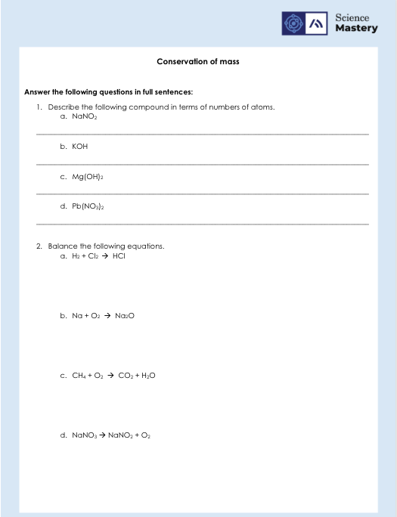
Conservation of Mass Worksheet

Slide 22

Describe: to recall facts, events or processes in an accurate way
Example question:
Describe how to balance a chemical equation.
To ‘describe’, your answer should:
Use bullet points.
Include each step of the process in a logical order.
Use keywords throughout the answer
Stay focused on the question.
Model answer:
Balanced chemical equations must have the same number of each type of atom on the reactant side and the product side.
Count the number of each type of atom on both sides
If they are already equal the equation is balanced
If they are not equal, coefficients should be added in front of formulae
Subscripts cannot be added or changed
Coefficients should be added until there are the same number of each type of atom on both sides
Notes:
This slide models the process of answering a describe question.
Firstly, students are presented with a generic describe question, along with a model answer. Students are also given some simple guidance to follow for producing their own describe answer.
The generic question and answer should be used by the teacher to remind students of
the key features of a great answer
how to structure their answer
why the model answer is a good example
Following this, students will be required to apply this process to answer their own describe question, which will appear in place of the generic questions. This describe question will be specific to the topic students are learning about in the lesson. Give students time to write their own answer to this, ensuring that they use the guidance provided. To further scaffold this task for students, it may be appropriate to:
pair students up to write an answer together
list for students the key words you would like them to include in the answer
provide a writing frame or ‘points to include’ for students
A model answer for this question will appear. Teachers should review the model answer with students by referencing the guidance in the green box. For example ‘we can see item 1 in the guidance is to use bullet points to keep your answer clear. Notice in the model answer here we have done just that’. Or ‘item 2 in the guidance here says that we should use scientific keywords in the answer. Has this been achieved in the model answer? Where can we see this?’.

Slide 23
Answer the questions below.
Predict the products of the following equation:
Zn + 2 HCl →
A. ZnCl₂ + H₂
B. ZnCl + H₂
C. ZnCl + H
2. How many hydrogen atoms make up the products of this reaction?
8 CO + 17 H₂ → C₈H₁₈ + 8 H₂O
A. 28
B. 16
C. 34
3. Which equation demonstrates the law of conservation of mass?
A. CH₄ + 2 O₂ → CO₂ + H₂O
B. CH₄ + O₂ → CO₂ + 2 H₂O
C. CH₄ + 2 O₂ → CO₂ + 2 H₂O
✓
✓
✓
Notes:
Q1. Answer: A
If students answer B, it suggests they do not think that the coefficient ‘2’ multiplies the chlorine part of the HCl. If students answer C, it suggests that they have ignored the coefficient of ‘2’. To fix-it, show students using molymods model of HCl what that 2 actually means – it’s 2 of the whole molecule. Have students practice counting the numbers of atoms shown in equations.
Q2. Answer: C
If students answer A, it suggests that they have added 18 to 10, 10 being the number of atoms of hydrogen they’ve incorrectly calculated is in H2O. In this case, students have added the 8 and 2 together instead of multiplying. If students answer B, it suggests they have only counted the hydrogens in the water, and not in the other product. To fix-it, give students similar equations to count the number of different types of atoms in to practice this. Show students that the atoms may not be together in the equation, and they should count all atoms on the right hand side of the arrow as these are all products.
Q3. Answer: C
If students answer A or B, it suggests that they are either not sure what is meant by conservation of mass or have difficulty recognising a balanced equation. To fix-it, give students equations to help them practice working out if equations are balanced and explain how this links to the law of conservation of mass.

Slide 24
Lesson C3.2.5
What was good about this lesson? | What can we do to improve this lesson?
Send us your feedback by clicking this link
or by emailing sciencemastery@arkonline.org
Thank you!

